Slide 1
Insurance On a Blockchain
Jelmer van Ginkel

Slide 2
Traditional Insurance issues
Information asymmetry
Transparency
Minimal customer interaction
Lack adoption of technology
Highly regulated

Slide 3
Blockchain based insurance
Peer-to-Peer Insurance
Parametric Insurance
Information asymmetry
Transparency

Slide 4
Existing Applications
Etherisc
Nexus Mutual
Teambrella
Augur (prediction market)

Slide 5
Potencial use cases
Life insurance
Flight delay insurance
Insurance on Bicycles and cars
Earthquake insurance

Slide 6
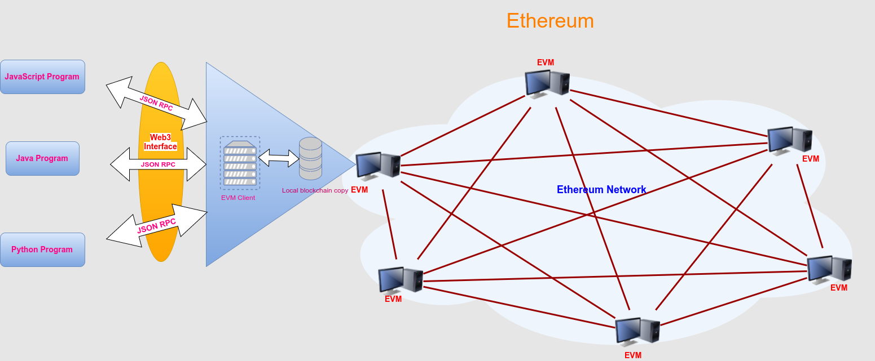


Ethereum

Slide 7
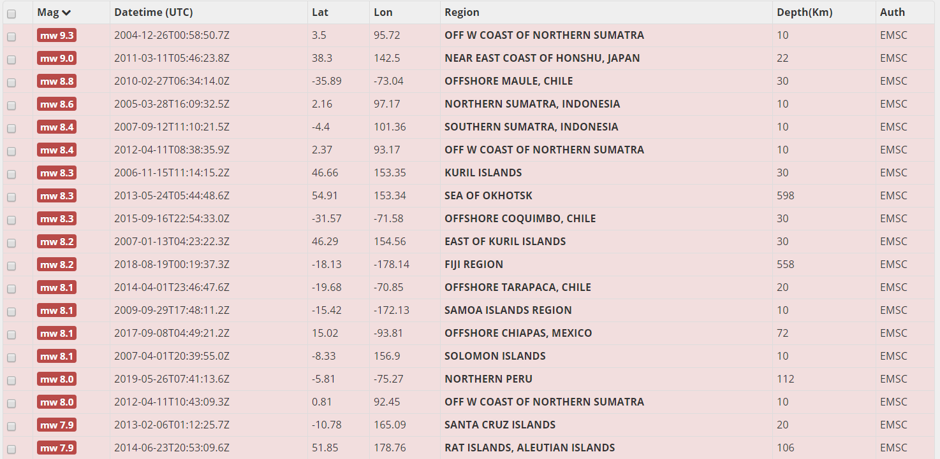
Public Earthquakes data
https://www.seismicportal.eu/

Slide 8
IPFS
Decentralized file Storage
Dockerfile and Python script
Risk Assessment Query
Https://ipfs.io/ipfs/Qmb4kYSAHJgBFwMQekihpTn7cjiGxnZbzRvbN8t9RZ57k8
Claim Verification Query
Https://ipfs.io/ipfs/QmQEpCpx23bLKG7YRJT5fE5ymr2nRvCnvj6KP9GocqUiRY

Slide 9
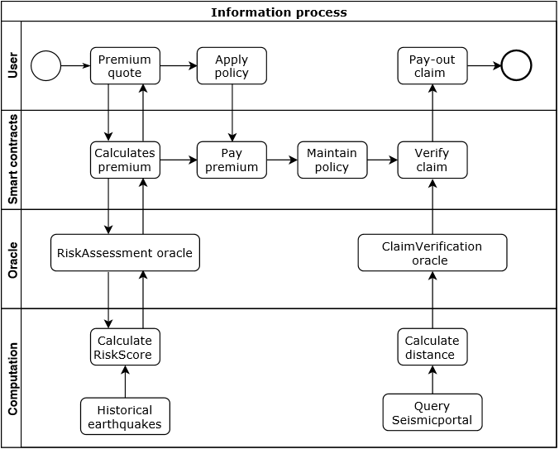
Earthquake insurance Application

Slide 10
Further Development
Implement Etherisc framework
Add Soil and Construction
Apply machine learning
Claim query
Dapp(build user interface) ☺

